Slide 1
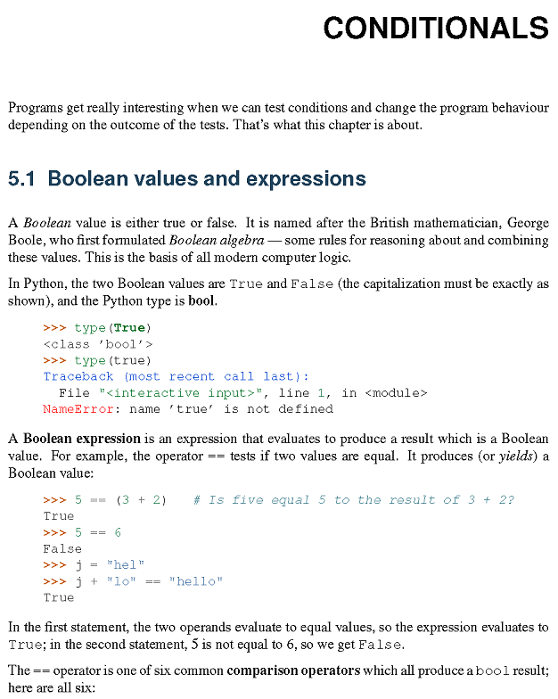

Slide 2
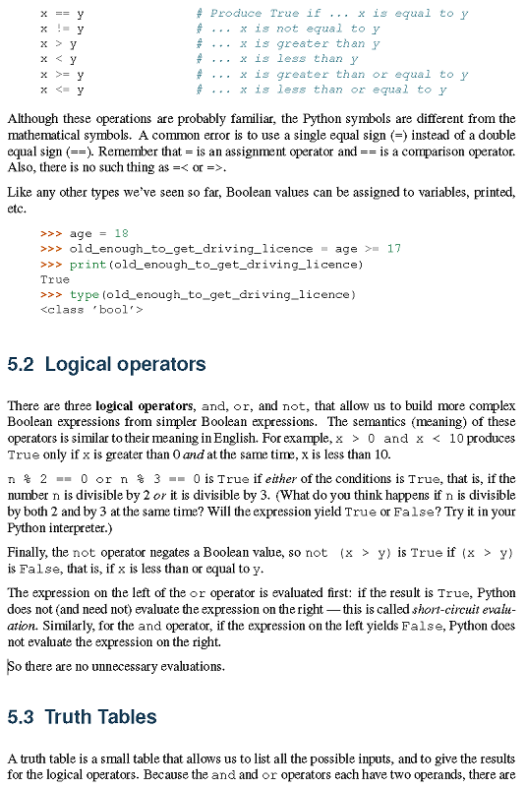

Slide 3
WS ch5_1
For ints from 1 to 20, which ints n is (n % 2 == 0) and (n % 3 == 0) ?
For ints from 1 to 20, which ints n is (n % 2 == 0) or (n % 3 == 0) ?
What ints from 1 to 20 satisfy neither condition?

Slide 4
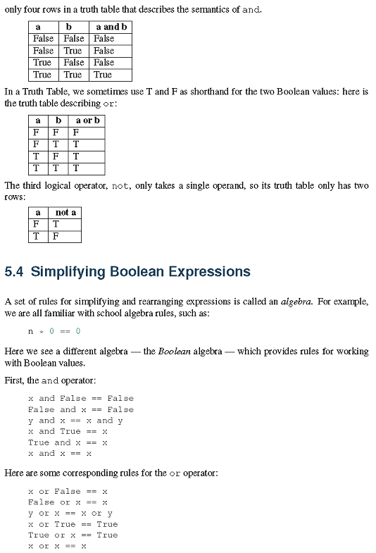

Slide 5
WS ch5_2.py
WS ch5_2
Make a truth table for p and (q or r). How many rows will the table have?

Slide 6
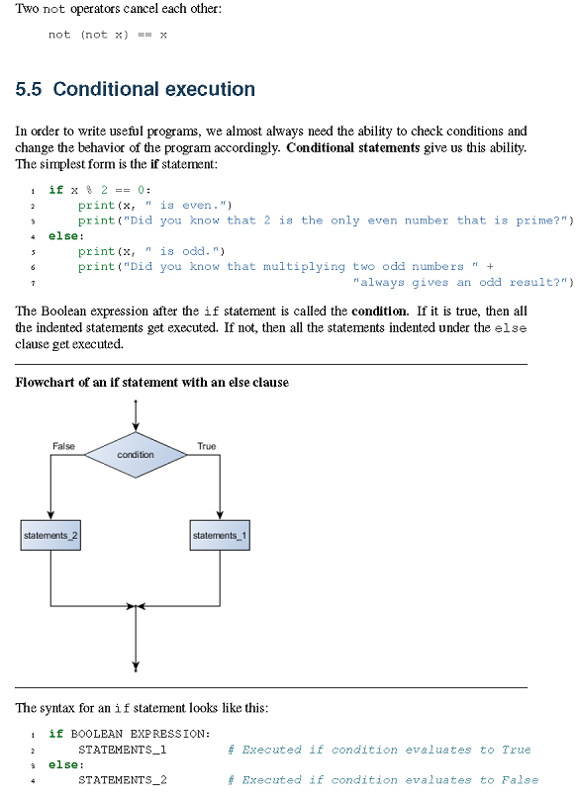

Slide 7
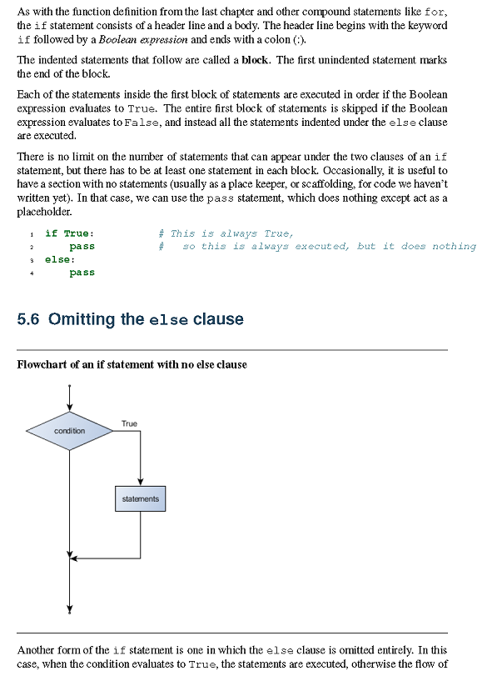

Slide 8
WS ch5_3.py
Write a function, tell_if_NZP(num), which prints out an appropriate message
telling if num is negative, zero or positive. Assume that num is an int.
Test the function on ints from -2 to 2.
WS ch5_4
Find all ints from 2 to 250 that are divisible by 7 but not divisible by 3
or by 5

Slide 9
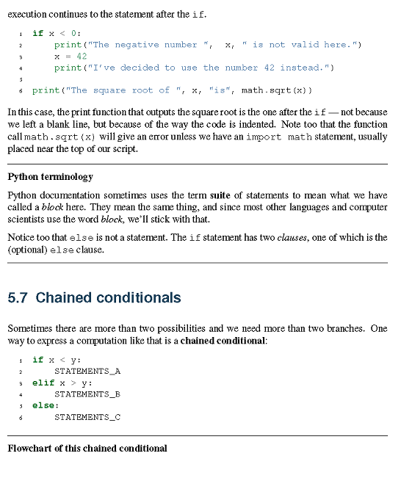

Slide 10
WS ch5_5
Write a function, tell_if_d3_and_not_d5(num),
which prints out an appropriate message for all num
regarding if num is divisible by 3 but
not divisible by 5.
Use this function to print out an appropriate message
for each int from 2 to 20.

Slide 11
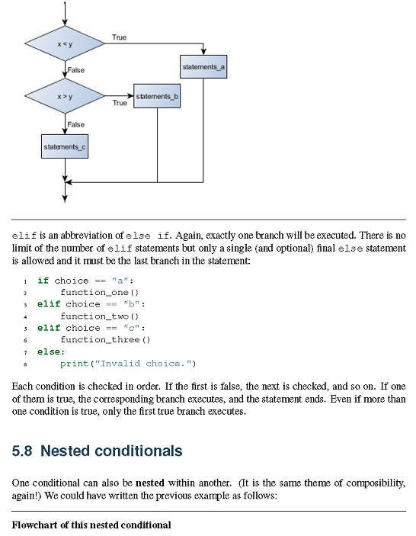

Slide 12
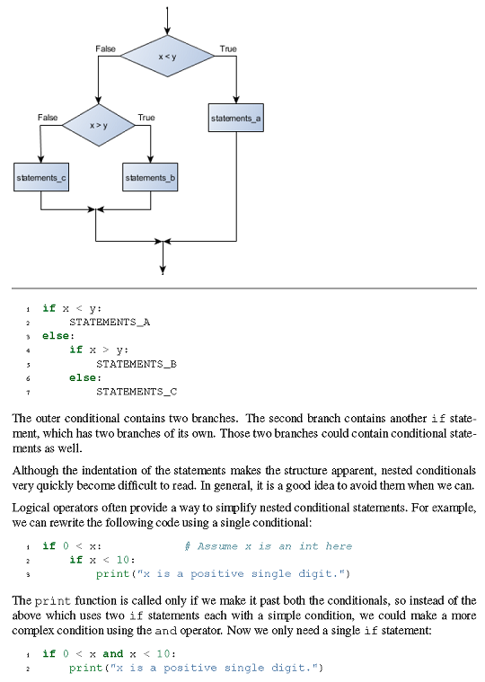

Slide 13
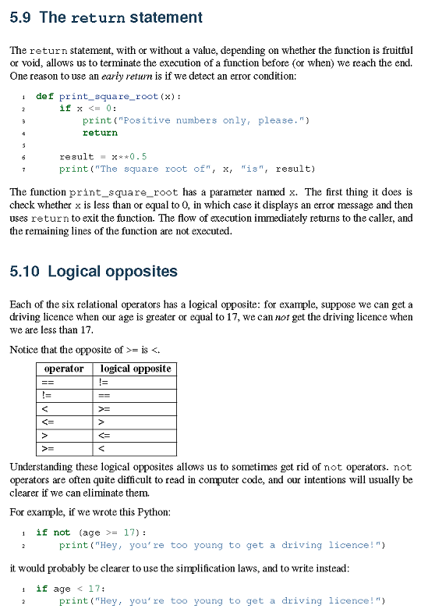

Slide 14
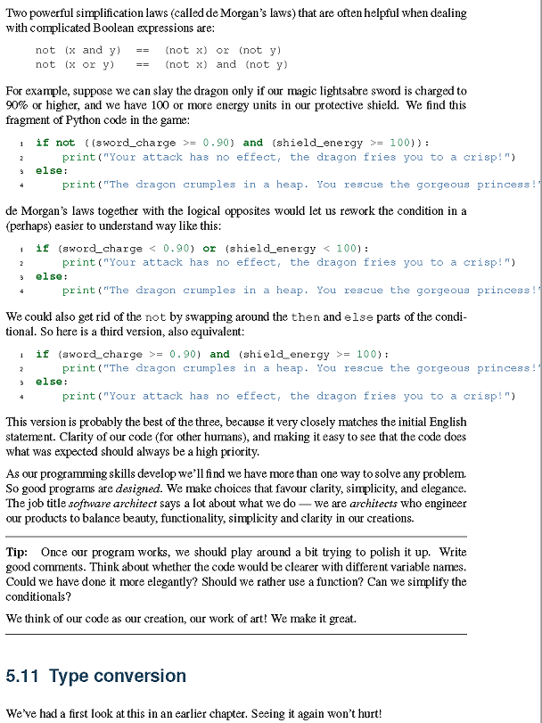

Slide 15
WS ch5_6
Make a truth table for
not(x and y) & (not x) or (not y)
and show that they are equivalent.

Slide 16
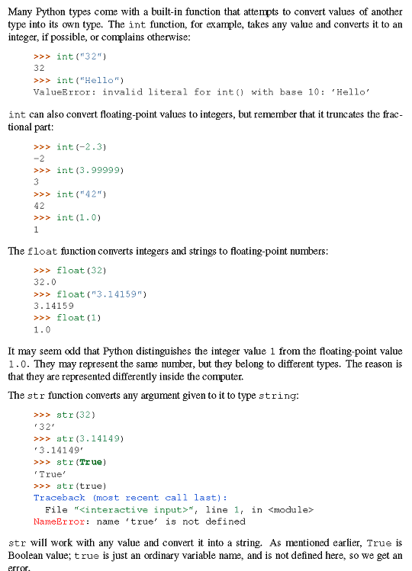

Slide 17
WS ch5_7
Example of a function that returns 2 items:
def sum_diff(x,y):
'''Returns sum and difference of x and y.'''
Sum = x + y
Diff = x - y
return Sum, Diff
##How to use it:
S,D = sum_diff(5,3)
print(S,D)
Write a function, sumSqrs_diffSqrs(x,y), which returns x^2 + y^2 and
x^2 - y^2. Use sumSqrs_diffSqrs(x,y) to compute 4^2 + 2^2 and 4^2 - 2^2.

Slide 18
WS ch5_8
Items can be added to a list using the append method:
L = [] ## empty list
print(L)
L.append(2)
print(L)
L.append('dog')
print(L)
>>>
[]
[2]
[2, 'dog']
>>>
Write a function, sep_ints_and_strgs(L), which takes a list, L,
of ints and strings, as a parameter, and which returns 2 lists, one
containing the ints from L and the other containing the strings
from L. Use this function to process the list
['dog', 3, 7,2,'cat','5']
and print out a list of ints and a list of strings.

Slide 19
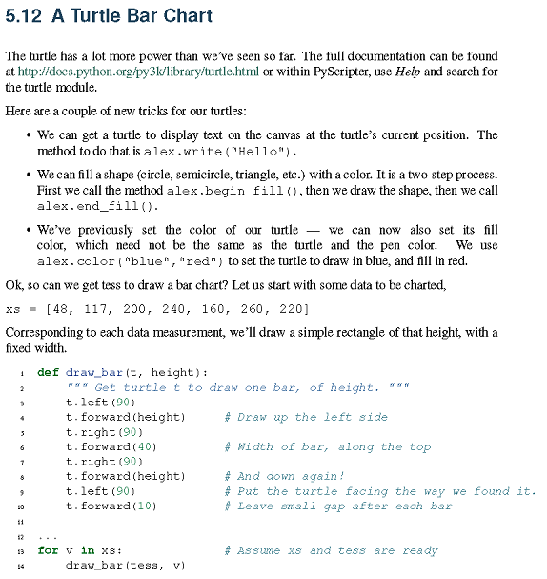

Slide 20
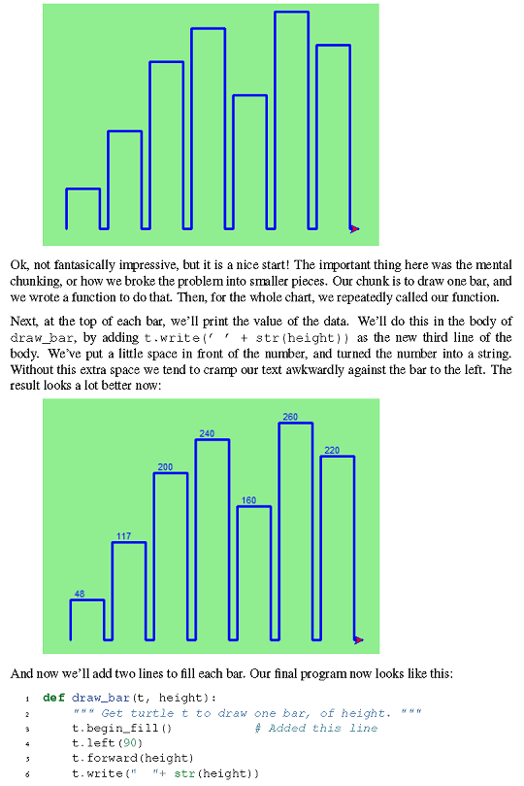

Slide 21
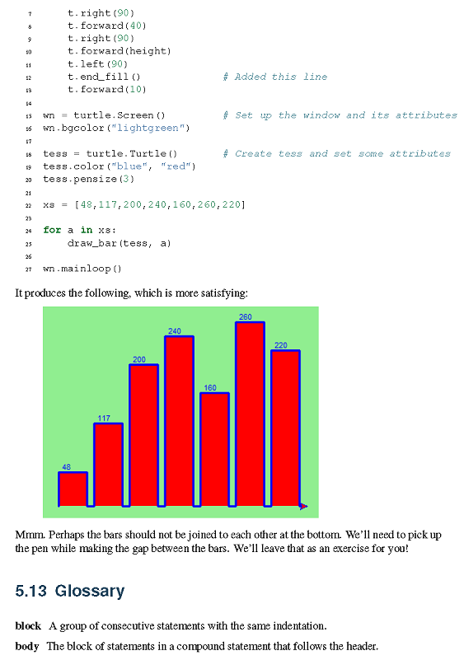

Slide 22
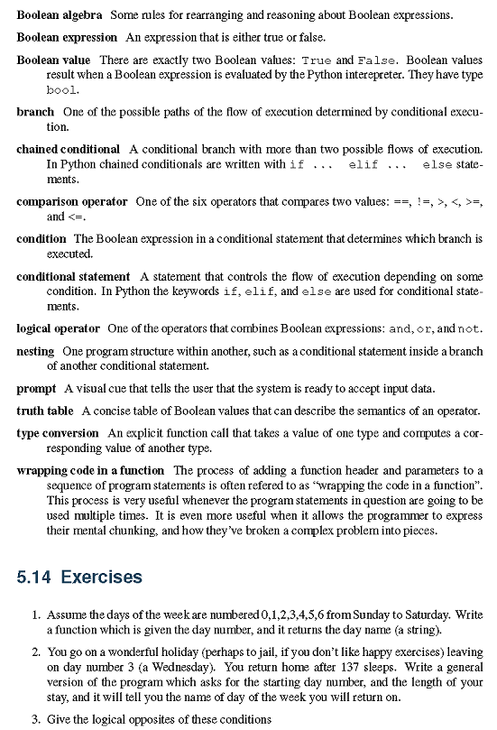

Slide 23
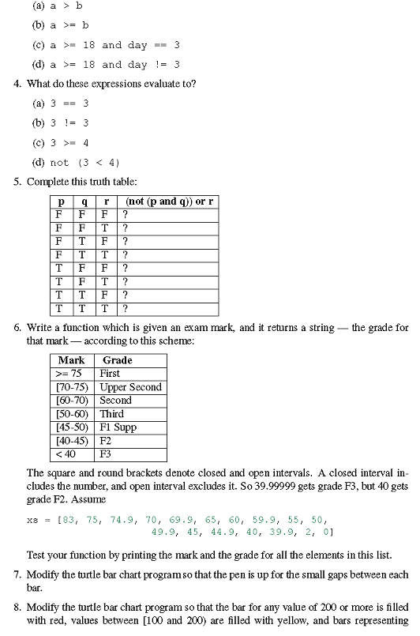

Slide 24
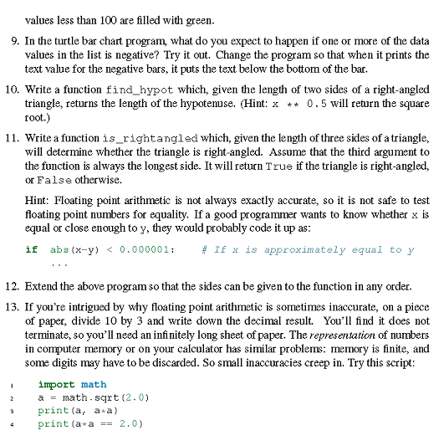

Slide 25
HW: 1,2,6,10,12
Youtube: 8

